Slide 1







NARI
Celebrating Womanhood,
Every day.

Slide 2


Table of contents
Home
Product page
(i) All products
(ii) Period Care
(iii) Intimate Care
(iv) Hygiene
(v) Personal Safety
Blog
Contact Us
Cart
Login
About Us
Terms and Condition
Product

Slide 3





What is
NARI?
In a world where women's health can sometimes be overshadowed, Nari emerges as a guiding light, illuminating the path to empowerment and self-care. Our mission is twofold: to provide access to top-notch sanitary products that ensure comfort and hygiene, and to create a supportive space where women can openly discuss and learn about intimate health concerns.

Slide 4

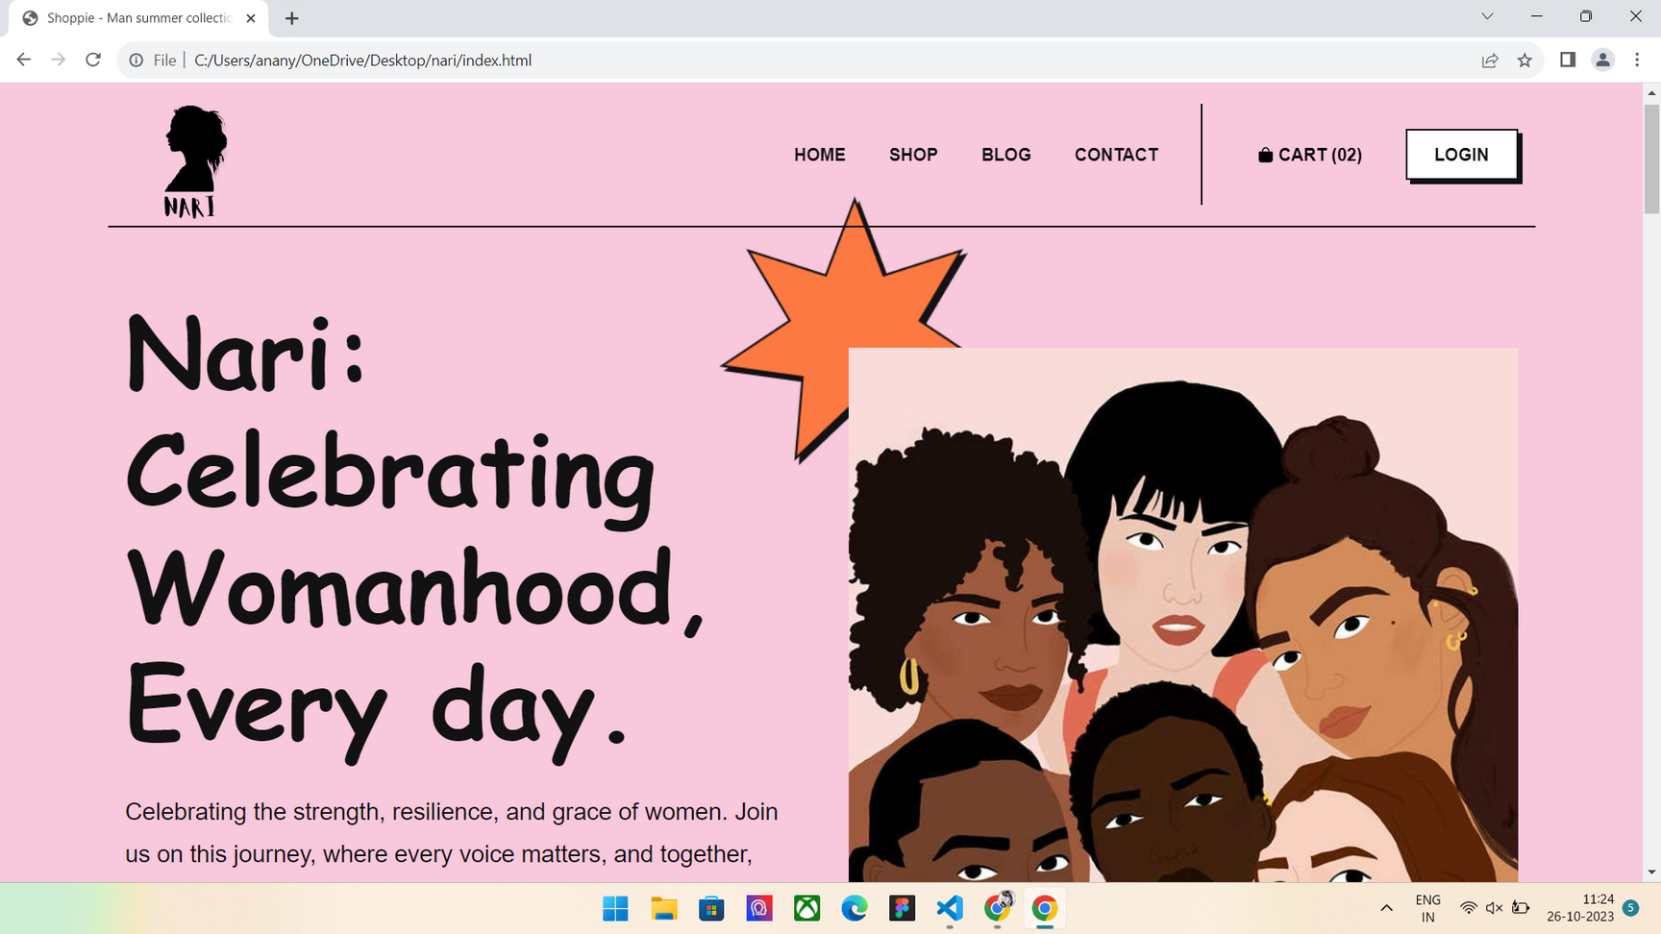
Our home page

Slide 5

Why we are
DIFFERENT?
Nari is more than just a marketplace; it's a community of like-minded women. We are not just here to sell products; we are here to make a difference.
Nari actively advocates for women's health rights and promotes awareness campaigns to educate society about the importance of addressing intimate health issues without shame or prejudice.

Slide 6
PROBLEM WE FACED
01.
TECHNICAL CHALLENGES
Design and User Experience
Making this website was not an easy task and overtime I faced many problems but eventually we solved those problems over the course of time.
02.
Content Management
03.

Slide 7


HOW I SOLVED THOSE
Problem?
SOLUTION 2
SOLUTION 1
user research to understand my target audience better.
SOLUTION 3
ensuring that the content remained up-to-date with minimal manual intervention
extensively researched online resources, forums, and documentation

Slide 8


THANK YOU

